Slide 1
note to the reader
These credentials are provided for your reference as a member of thenetworkone. You may use them or, the elements therein, internally or externally, to promote your membership of thenetworkone and, the international capabilities now available to your agency that your membership facilitates.
Please feel free to adapt the content to your house-style.
If you have any specific questions or requirements, please don’t hesitate to contact us directly.

Slide 2
thenetworkone
An introduction for new members
www.thenetworkone.com
julian.boulding@thenetworkone.com
helen.anderson@thenetworkone.com
stephanie.fox@thenetworkone.com

Slide 3
thenetworkone: what we do for agencies
thenetworkone helps independent agencies of all marketing and communications disciplines, to pitch and win assignments from international clients – and manage them successfully.

Slide 4
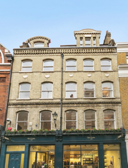
key facts
the world’s largest independent agencies network
founded 2003
headquarters in London, UK
1,200 agencies in 116 countries worldwide
each agency personally visited, evaluated and accredited
creative, media, PR and all forms of digital communications

Slide 5
thenetworkone people:
Julian Boulding
president
Helen Anderson
managing director
Stephanie Fox
international consultant
Anna Poloczek
database coordinator

Slide 6
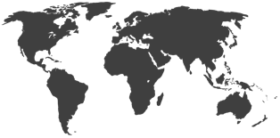
where we work:
Afghanistan
Albania
Algeria
Angola
Argentina
Australia
Austria
Azerbaijan
Bahrain
Bangladesh
Belarus
Belgium
Benin
Bolivia
Botswana
Bosnia
Brazil
Bulgaria
Cambodia
Canada
Cameroon
Chile
China
Colombia
Costa Rica
Croatia
Cyprus
Czech Republic
Denmark
Dem. Rep. Congo
Dominican Republic
Ethiopia
Estonia
Ecuador
Egypt
Finland
France
Georgia
Germany
Ghana
Greece
Guinea-Bissau
Guinea-Conakry
Hungary
Iceland
India
Indonesia
Iran
Iraq
Ireland
Israel
Italy
Jamaica
Japan
Jordan
Kazakhstan
Kenya
Kosovo
Kuwait
Laos
Latvia
Lebanon
Liberia
Lithuania
Macedonia
Malaysia
Malta
Mauritius
Mexico
Morocco
Myanmar
Namibia
Nepal
Netherlands
New Zealand
Nigeria
Norway
Oman
Pakistan
Panama
Paraguay
Peru
Philippines
Poland
Portugal
Qatar
Romania
Rwanda
Saudi Arabia
Serbia
Singapore
Slovakia
Slovenia
South Africa
South Korea
Spain
Sri Lanka
Sudan
Sweden
Switzerland
Taiwan
Tanzania
Thailand
Trinidad and Tobago
Tunisia
Turkey
Uganda
Ukraine
United Arab Emirates
United Kingdom
USA
Uruguay
Venezuela
Vietnam
Yemen
Zambia
Zimbabwe

Slide 7
a selection of our clients
many of our assignments are confidential, but here are some examples of companies we have worked for – either directly, or for their lead agencies – B2C and B2B:

Slide 8
finding and accrediting agencies
what do we need and where
desk
research by market
meet in person or by Zoom
agree basic terms of business
add to our extensive database

Slide 9
finding the right partners for you
location
capabilities
experience
role
availability
fit

Slide 10
helping agencies work together
help with contracts
international account directors
ongoing support

Slide 11
how do we get paid?
transparency is important to us and to you
we receive a membership fees from agencies who wish to join
we will receive a referral fee when we successfully introduce new business to your agency
our fee is 7% of the net fee or commission income which you receive from the new client, for one year from the date of your first invoice to them
we host free webinars for independent agencies, but also personalised workshops and events for which we charge, including our annual ‘indie Summit’ conference
we undertake bespoke consultancy projects on request

Slide 12
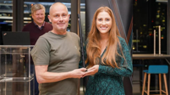
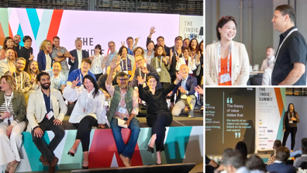
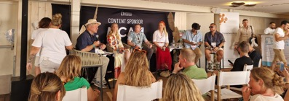
knowledge sharing, development & community
Webinar Wednesdays
inter-agency staff exchange program
online consultancy, leadership development, training and networking
inter-agency mentoring program

Slide 13
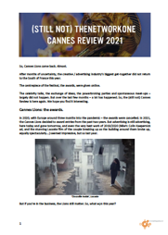
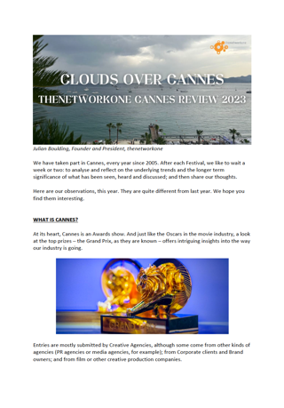
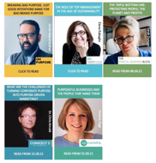
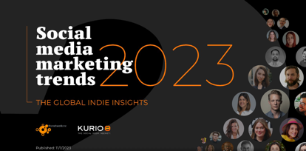
thought leadership
The World’s Leading Independent Agencies
Special interest groups:
Sustainable Development
Trend reports
The Cannes Review

Slide 14
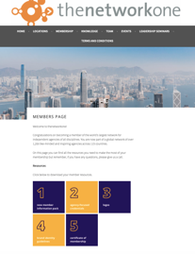
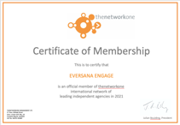
new member check list…
check out the ‘new member resources page’ https://thenetworkone.com/new-members-page/
complete our database form and send us your credentials / work
send out a press release about your membership
tell your clients and prospects about your network. Add us to your website and email footers
make sure your team know about their network
keep us informed about your work and agency life
join our free webinars and attend our events
if in doubt, just ask us – we are here to help

Slide 15
case histories

Slide 16
case history: Kolle Rebbe & Lufthansa
opportunity
Kolle Rebbe had the opportunity to pitch for Lufthana’s global advertising business.
solution
Worked with Kolle Rebbe to build a network of ‘hub’ agency partners in China, Japan, UAE and USA to co-create and localise work
outcome
Kolle Rebbe won the pitch in 2011 and have held and grown the account since. They have adapted the model for other international accounts

Slide 17
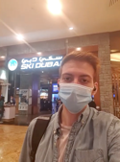
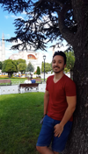
case history: bringing a pitch to life. Made in Italy.
opportunity
Milan based agency Changee, had the opportunity to pitch for the ‘re-launch’ of Italy to tourists post pandemic. Needed to show they understood what the global community thought of Italy.
solution
Arrange for agencies in 24 countries around the world to record vox-pops in agency, on-street or at home (depending on local lock-downs) to gather people’s perceptions of Italy. Then create a ‘mood film’
Outcome
Won the account – then Italy went back into lock-down!

Slide 18
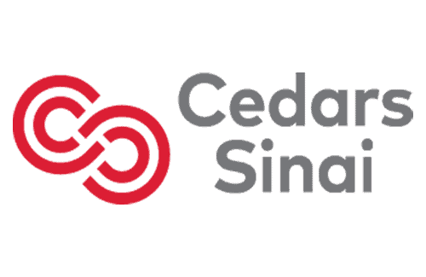
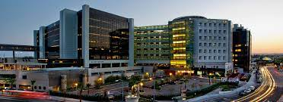
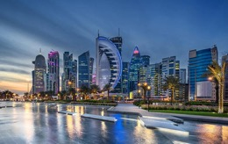
case history: US healthcare in the Middle East.
opportunity
The world famous Cedars Sinai hospital asked Californian based agency, RPA to help them identify and then attract high-net worth patients from Qatar to be treated in the US.
solution
Many sensitivities to be taken into account – personal and social. thenetworkone introduce RPA to Doha based agency Brand Empire who are well connected and understand local issues and the healthcare landscape in Qatar.
Outcome
Currently co-creating a locally sensitive campaign for the client.

Slide 19
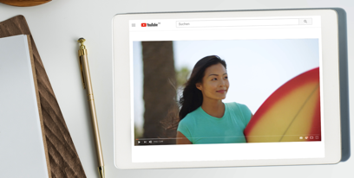
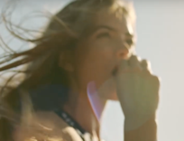
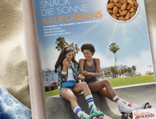
case history: Sterling-Rice Group & Damm & Bierbaum
opportunity
Sterling-Rice Group in the US needed a partner to create the Californian Almond Board’s first ad campaign in Germany
solution
Recommended Damm & Bierbaum: a creative agency with digital skills and sector experience
outcome
Damm & Bierbaum launched a campaign on TV, social media and print to establish almonds as a modern and light snack

Slide 20
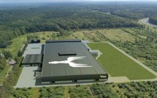
case history: China partner for Metsä
opportunity
Finnish agency hasan&partners works with Metsä, an international forest industry group and producer of wood and paper products. Metsä needed to support their channel in China.
solution
Identify specialist B2B partner agencies in Shanghai able to trans-create channel materials supplied from hasan&partners.
outcome
hasan&partners introduced to Brandigo – a B2B agency that helps brands enter China.

Slide 21
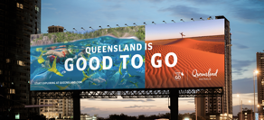
case history: Tourism & Events Queensland
opportunity
Australia based agency Rumble needed work with local agencies in Spain, LatAm, USA, China, Korea and Japan to win, adapt and create work to promote Queensland during the pandemic.
solution
select agencies with suitable experience, build network and connect all parties.
outcome
local partners appointed and working together to adapt centralised campaigns and generate local ones.

Slide 22
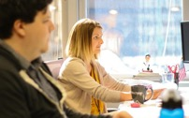
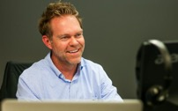
case history: international B2B agency partnerships
opportunity
Colorado based agency 90octane needed partners in the UK to service several existing clients.
solution
Conduct a review of the UK agency landscape to identify suitable partners that had the right skill and experience and shared 90octane’s values.
outcome
Several partners identified and now working together on client projects. Project scope now extended to include more countries.

Slide 23
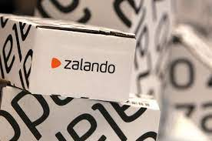
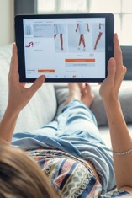
case history: Smarts Agency & zalando
opportunity
The Smarts Agency was asked by their online retail client zalando, to provide local PR to support for market launches in the Balkan and Baltic regions.
solution
As both regions contains multiple but small markets, thenetworkone suggested appointing one hub agency in Estonia and one in Croatia that could provide on the ground support as required.
outcome
Following an internal review of three agencies per region, Optimist PR, Estonia was appointed for the Baltics and, Komunikacijski Labs, Croatia for the Balkans. zalando successfully launched into both markets in late 2021

Slide 24
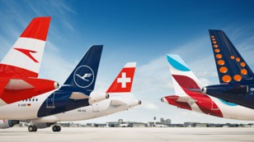
case history: Achtung! & Lufthansa – global PR network
opportunity
German based independent agency, Achtung!, wants to pitch for The Lufthansa Group’s global PR account.
solution
Identify suitable agency partners in 41 markets. Create a bespoke global network pre-pitch.
outcome
Achtung! is chosen to lead the global PR activities for the Lufthansa Group.

Slide 25
case history: Parmigiano Reggiano
opportunity
Italian agency, Different Global, were asked to pitch for one of the most important Italian food brands - Parmigiano Reggiano cheese.
solution
create a pan-European network with partner agencies in Germany, Switzerland, Spain, France & UK.
outcome
Different Global, along with their partners, won the pitch for Parmigiano Reggiano.

Slide 26
thank you, any questions?
thenetworkone
3rd Floor, 48 Beak Street
Soho
London, W1F 9RL, UK
www.thenetworkone.com
+44 207240 7117
@thenetworkone
julian.boulding@thenetworkone.com

